Slide 1


Slide 2

DEFINITION 1.1.

Slide 3

DEFINITION 1.2.

Slide 4

DEFINITION 1.3.

Slide 5

THEOREM 2.1.

Slide 6
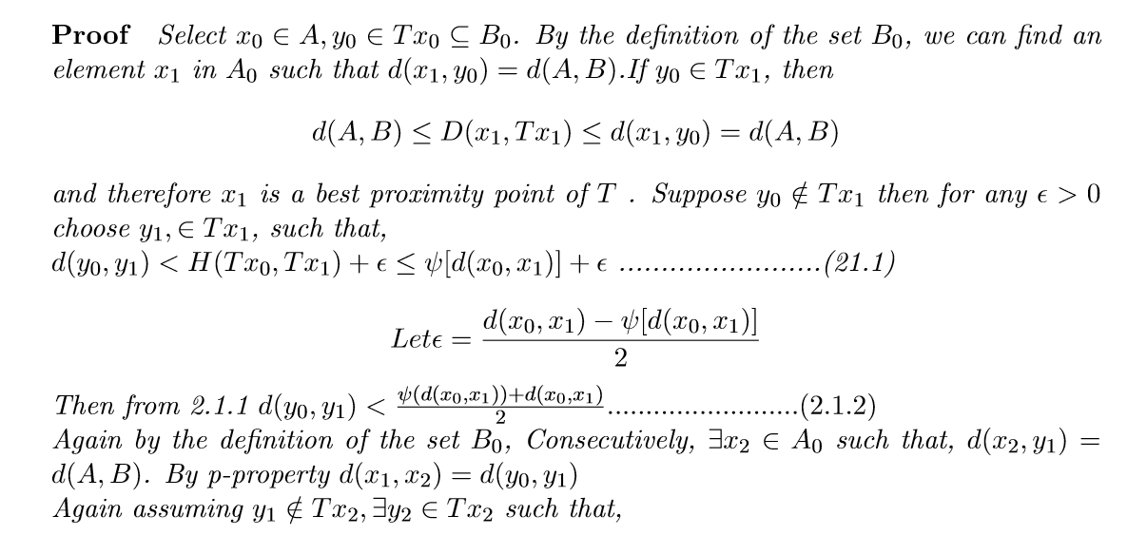
THEOREM PROOF

Slide 7
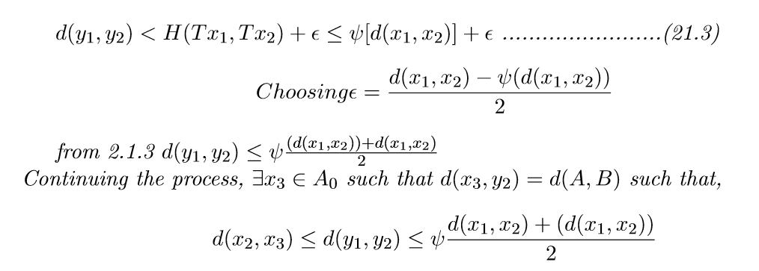
PROOF…

Slide 8
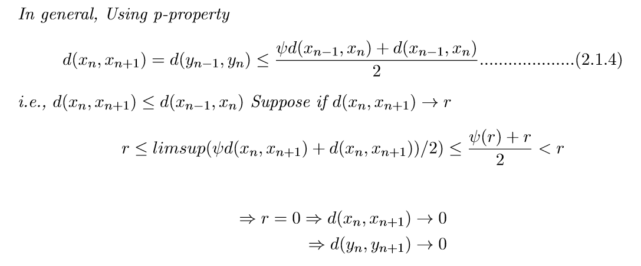

Slide 9
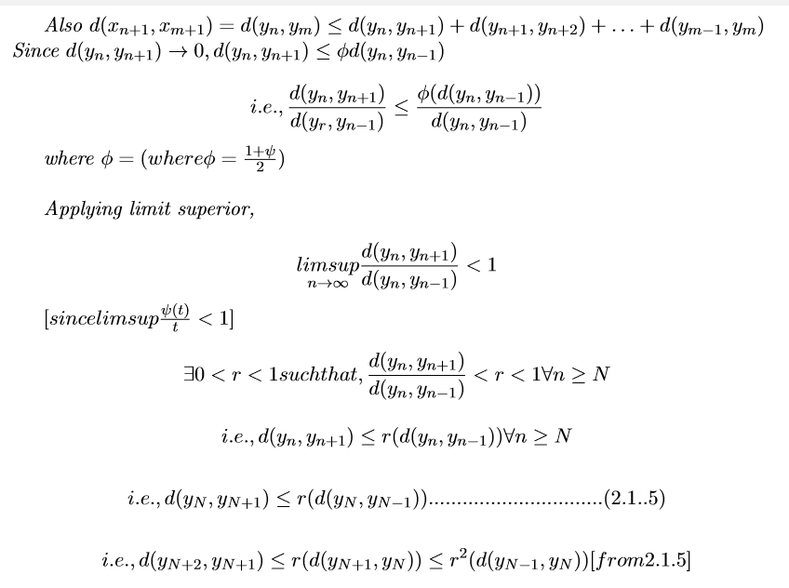

Slide 10
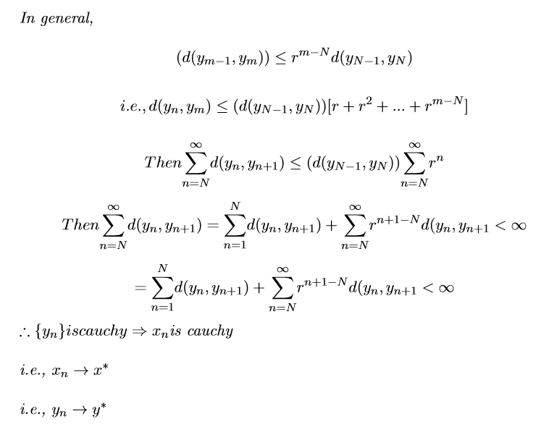

Slide 11


Slide 12
THANK YOU….

